Slide 1
Lecture 5
Introduction
to
Probability Distribution

Slide 2
Probability Distribution
Probability Distribution: A listing of all possible outcomes of an experiment and the corresponding probability. A probability distribution shows the possible outcomes of an experiment and the probability of each of these outcomes.
Example: Here's an example probability distribution that results from the rolling of a single fair dice.
x | 1 | 2 | 3 | 4 | 5 | 6 | sum
p(x) | 1/6 | 1/6 | 1/6 | 1/6 | 1/6 | 1/6 | 6/6=1

Slide 3
Types of Probability Distributions
There are two types of probability distribution.
1. Discrete probability distribution
2. Continuous probability distribution
Discrete probability Distribution: A discrete distribution describes the probability of occurrence of each value of a discrete random variable. A discrete random variable is a random variable that has countable values, such as a list of non-negative integers. Thus, a discrete probability distribution is often presented in tabular form.
There are many types of discrete probability distributions. Some of them are given below:
Bernoulli Distribution
Binomial Distribution
Poisson Distribution

Slide 4
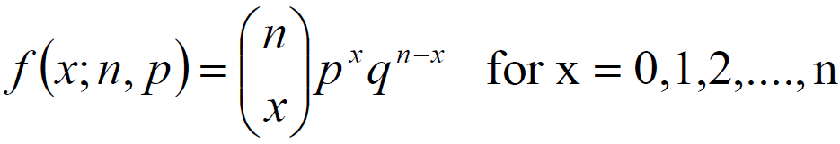

Binomial Distribution
Binomial Distribution: A binomial distribution can be thought of as simply the probability of a SUCCESS or FAILURE outcome in an experiment or survey that is repeated multiple times. Binomial distribution probability function is defined by:
n is the number of trials
x is the number of observed successes
p is the probability of success on each trial
q is the probability of failure = 1 - p
Mean: The mean of Binomial distribution, µ = np.
Variance: The variance of Binomial distribution,

Slide 5
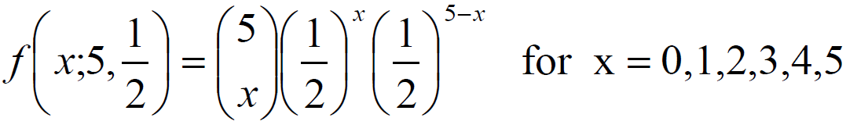
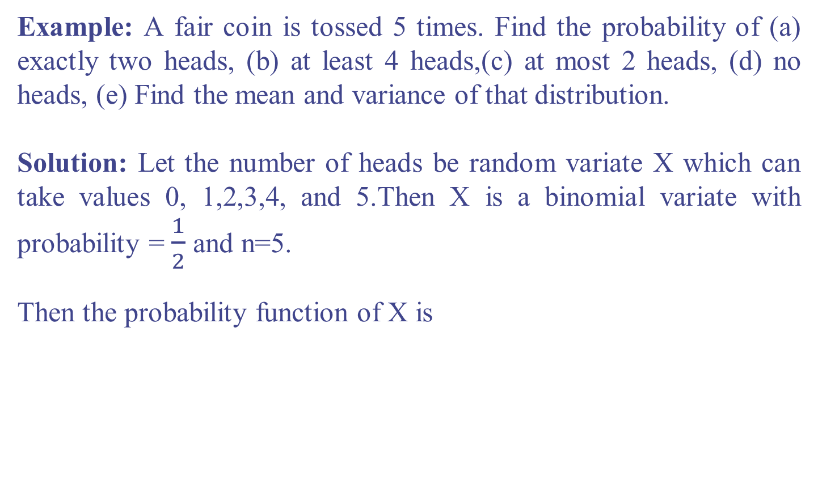
Example of Binomial Distribution
Example: A fair coin is tossed 5 times. Find the probability of (a) exactly two heads, (b) at least 4 heads,(c) at most 2 heads, (d) no heads, (e) Find the mean and variance of that distribution.
Solution: Let the number of heads be random variate X which can take values 0, 1,2,3,4, and 5.Then X is a binomial variate with probability = $\frac{1}{2}$and n=5.
Then the probability function of X is

Slide 6
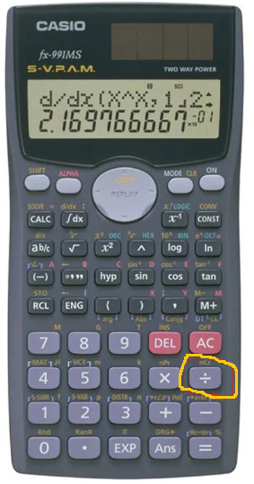
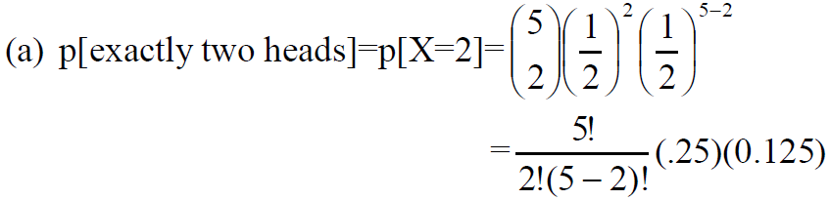
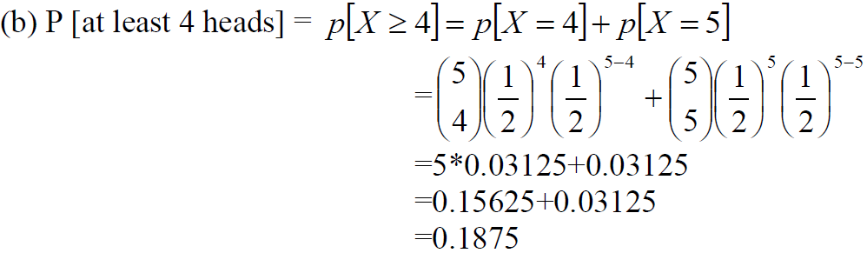
Binomial Distribution
S
= 0.3125
By using nCr formula

Slide 7
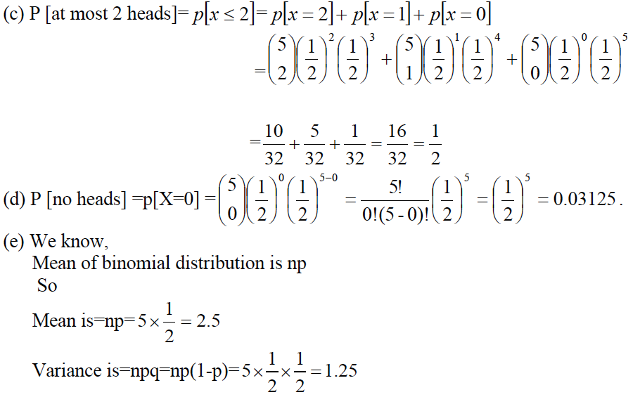
Binomial Distribution

Slide 8
Distribution Table
According to the given problem
Number of Heads | Probability | Cumulative Probability | RD Assignment
2 | 0.31 | 0.31 | 1 – 31
≥ 4 | 0.18 | 0.49 | 32 – 49
≤ 2 | 0.50 | 0.99 | 50 – 99
0 | 0.03 | 1.00 | 00

Slide 9
The End

